Slide 1

Connectionism
http://compcogscisydney.org/psyc3211/
A/Prof Danielle Navarro
d.navarro@unsw.edu.au
compcogscisydney.org

Slide 2
Structure of the “categorisation” lectures
L1: Connectionism
L2: Statistical learning
L3: Semantic networks
L4: Wisdom of crowds
L5: Cultural transmission
L6: Summary
Yes there’s some categorisation in these lectures, but not as much as you’d think. The name of this lecture series comes from the fact that I’m filling in for Brett Hayes and his lectures were more categorisation focused ☺

Slide 3
Structure of the lecture
Rescorla-Wagner rule
Backpropagation of error rule
From backprop to deep networks
The state of the art? Atari games?

Slide 4

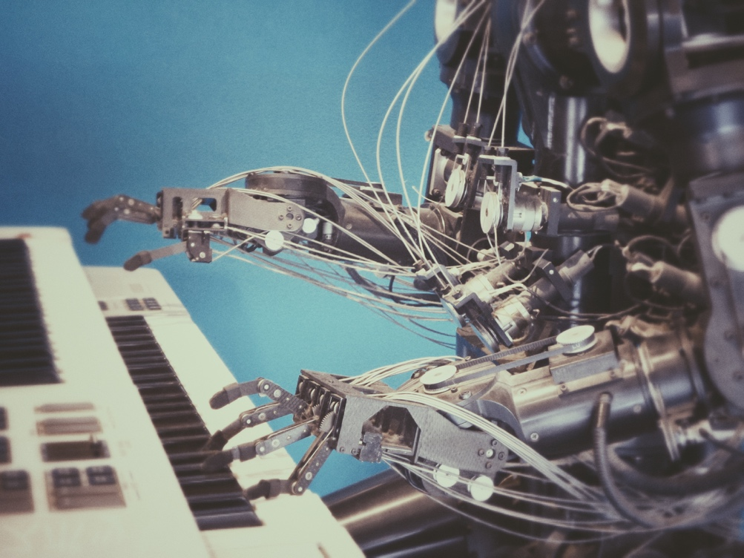
How do people learn?

Slide 5
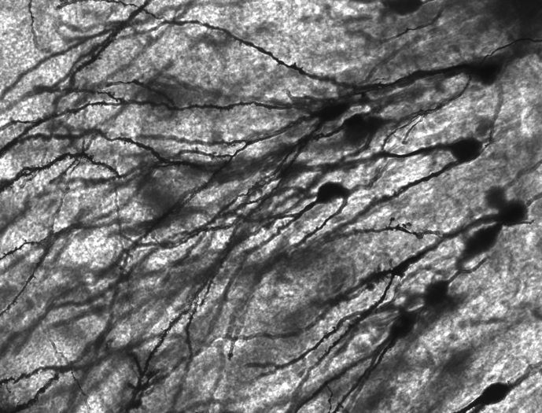
Two perspectives (among many!)
Connectionism
Neural networks
Biologically inspired
Learning from error
Pattern recognition
Flexible learning
This lecture!

Slide 6

Two perspectives (among many!)
Probabilistic models
Bayesian models
Statistical learning
Structured learning
Rich generalisation
Next lecture!

Slide 7
The Rescorla-Wagner model: An “error driven” learning theory

Slide 8
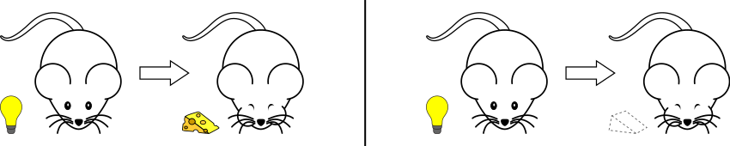
Associative learning
In the simplest design (forward conditioning) the CS is presented slightly before the US, so that it can serve as a signal that reward is coming
Unconditioned stimulus (US) – something inherently rewarding
Conditioned stimulus (CS) – something initially neutral

Slide 9
Associative learning
(well, Pavlovian anyway)
After some number of presentations, the learner starts to respond to the CS in the same way they would respond to the US
They have a learned association between the CS and the US

Slide 10
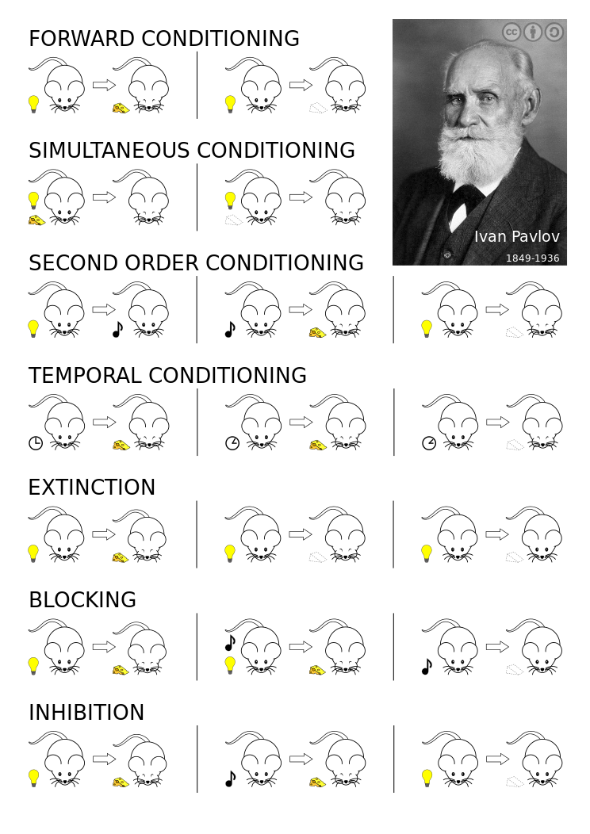
There are many variations on this!
(Long list of empirical effects to account for)

Slide 11

Rescorla-Wagner model
One popular (though incomplete) account of associative learning is the Rescorla-Wagner model
But what does this strange inscription mean?????

Slide 12


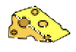
Rescorla-Wagner model
CS with two components
Consider a design in which there are two features present (X and Y) and the learner needs to predict an outcome that might be present (+) or absent (-)
US present
X
Y
+
An XY+ trial

Slide 13
Rescorla-Wagner model
The old strength of association for stimulus X
The new strength of association for stimulus X after seeing XY+
The difference between the old and the new. By convention “differences” are denoted “delta”, so we call this “delta-V”, ΔV

Slide 14
Rescorla-Wagner model
The “alpha” and “beta” terms here are parameters describing learning rates.
This delta-V describes “how much we learn about X from the current trial/event”
alpha depends on the conditioned stimulus (X, the thing that is acquiring the association)
beta depends on the unconditioned stimulus (the thing we’re learning to predict)
This isn’t an associative learning class so we’ll group them together in a single “learning rate”, gamma…

Slide 15
Rescorla-Wagner model
gamma is a learning rate
This term here is the “reward prediction error”

Slide 16
Rescorla-Wagner model
lambda is represents the “intrinsic” value of the outcome (unconditioned stimulus), sometimes referred to as the “reward”, r

Slide 17
Rescorla-Wagner model
reward
V_{xy} is the “predicted reward”: the amount of reward/punishment that the learner expects to receive upon seeing the compound stimulus XY
In the Rescorla-Wagner model, expectations are additive, which means that:
(But not all learning models assume additivity)

Slide 18
Error driven learning!
reward
expected reward
the difference between outcomes and expectations is the prediction error, and it is this error that “drives” learning
how much does the learner change their beliefs?
learning is gradual, and depends on a learning rate

Slide 19
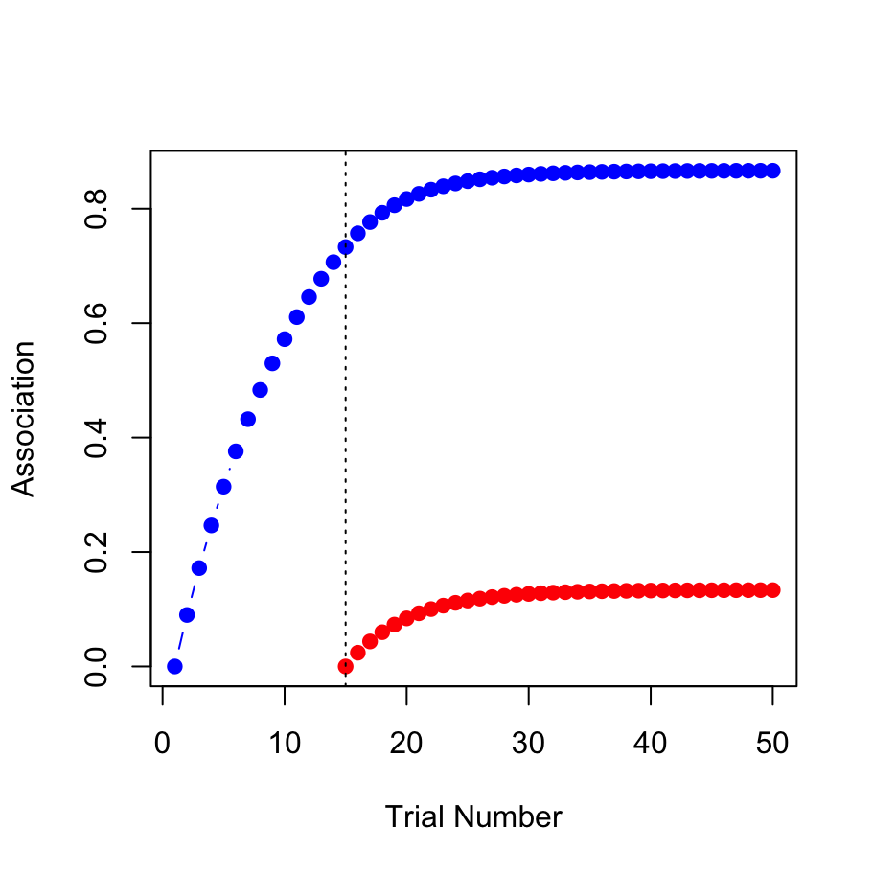
Example: Blocking
http://compcogscisydney.org/psyr/programming.html
X+
XY+
Associative strength for X
Associative strength for Y

Slide 20
Recasting the Rescorla-Wagner model as a simple neural network

Slide 21

What is a neural network?
Real neurons are complicated things
“Neural networks” are abstractions
Nodes receive input from other nodes
If the input exceeds a threshold, the node “fires”
Often a simplified “soft” threshold is used… instead of “firing” it just sends a transformed signal to the next node
Learning occurs by adjusting the “strength” of the connections between nodes

Slide 22

A feed-forward network
the associative strength describes the weight of the connection between the cue (e.g. X) and the reward
is X present?
yes
V_{x}
yes
V_{y}
???
predicted reward
is Y present?
V_{z}
no
is Z present?

Slide 23
A feed-forward network
is X present?
1
V_{x}
1
V_{y}
???
predicted reward
is Y present?
V_{z}
0
is Z present?
Convert the human-friendly words “yes” and “no” into numerical activation levels

Slide 24
A feed-forward network
Relabel the “values” as “connection weights”…
is X present?
1
w_{x}
1
w_{y}
???
predicted reward
is Y present?
w_{z}
0
is Z present?

Slide 25

A feed-forward network
The input is processed by passing it “through” the connection/association weights
1
w_{x}
The predicted reward produced when we pass the input through the connection weights is called the output
Collectively, the activation of these nodes describe an input pattern
w_{y}
1
???
w_{z}
0

Slide 26
Learning by back-propagating error
Δw_{x}
Δw_{y}
r_{obs} – r_{pred}
Δw_{z}
The difference between the actual reward and the output is used to adjust the connection weights using an error driven learning rule

Slide 27
Using neural networks to solve categorization problems

Slide 28
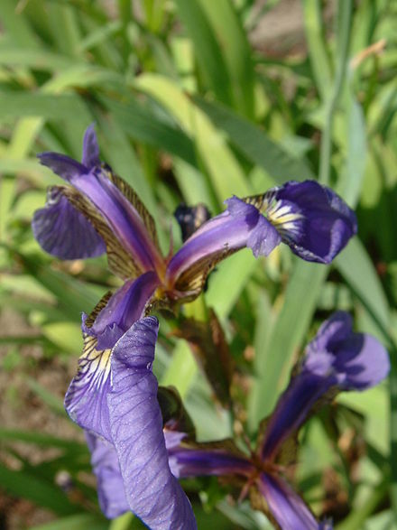
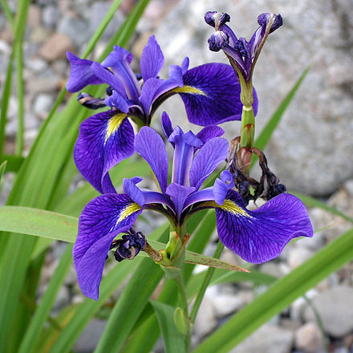
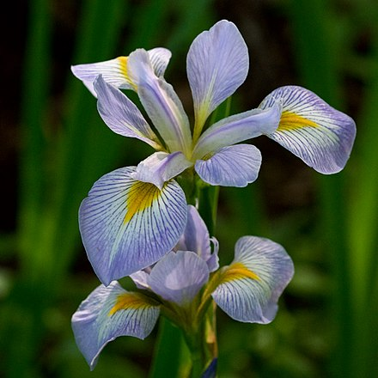
How to classify irises????
Iris setosa
Iris versicolour
Iris virginica
(a classic data set collected by Edgar Anderson, reported by Sir Ronald Fisher 1936)

Slide 29
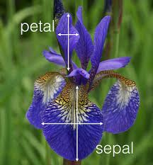
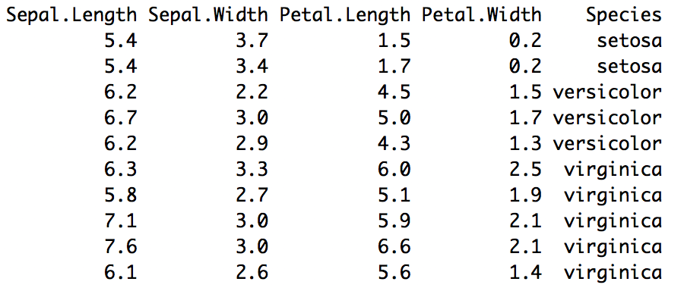
This is a “compound” stimulus with many features (at least four)

Slide 30
Our first connectionist network
1
How long is the petal?
???
Is it a setosa?
1
How wide is the petal?
???
Is it a versicolor?
0
How long is the sepal?
???
Is it a virginica?
0
How wide is the sepal?
Each of these links represents an association strength that we can acquire through repeated experience

Slide 31
Our first connectionist network
1
???
Some technical detail…
1
Nonlinear activation function
Bias parameters for contextual learning
Delta rule subtly different from R/W
???
0
???
0

Slide 32
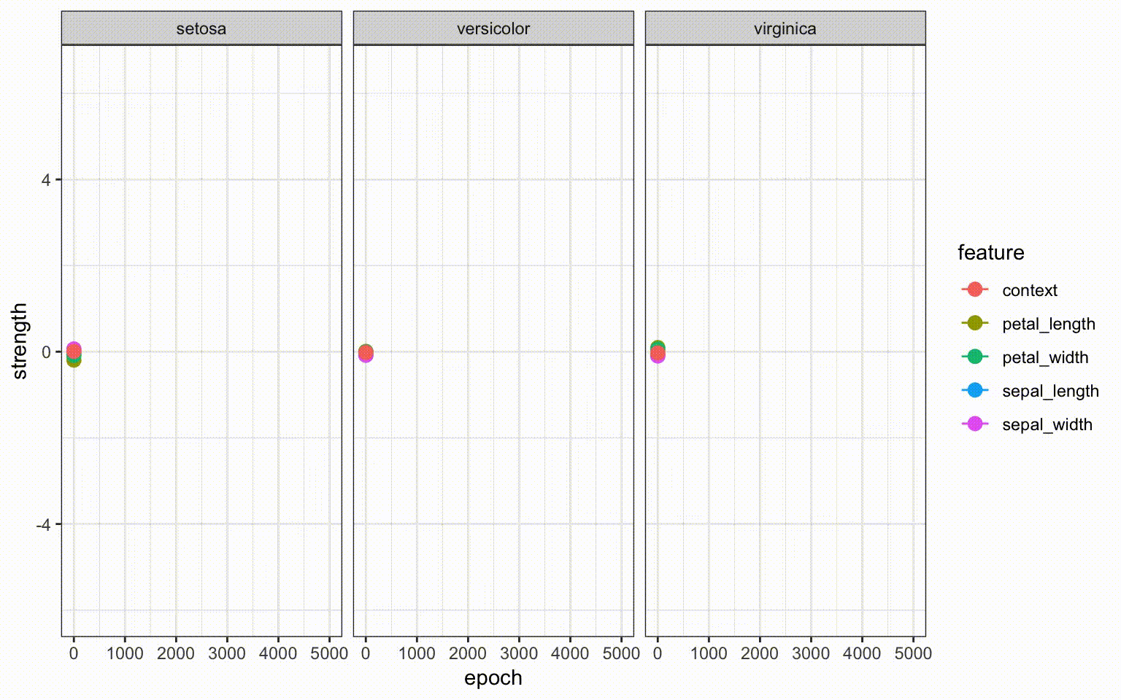
Learning connection weights
1
???
1
???
0
???
0
http://compcogscisydney.org/psyr/backprop.html

Slide 33
Building richer networks
(and understanding what they are good at)

Slide 34
Some networks have hidden layers
in₁
hid₁
out₁
in₂
hid₂
out₂
in₃
hid₃
out₃

Slide 35
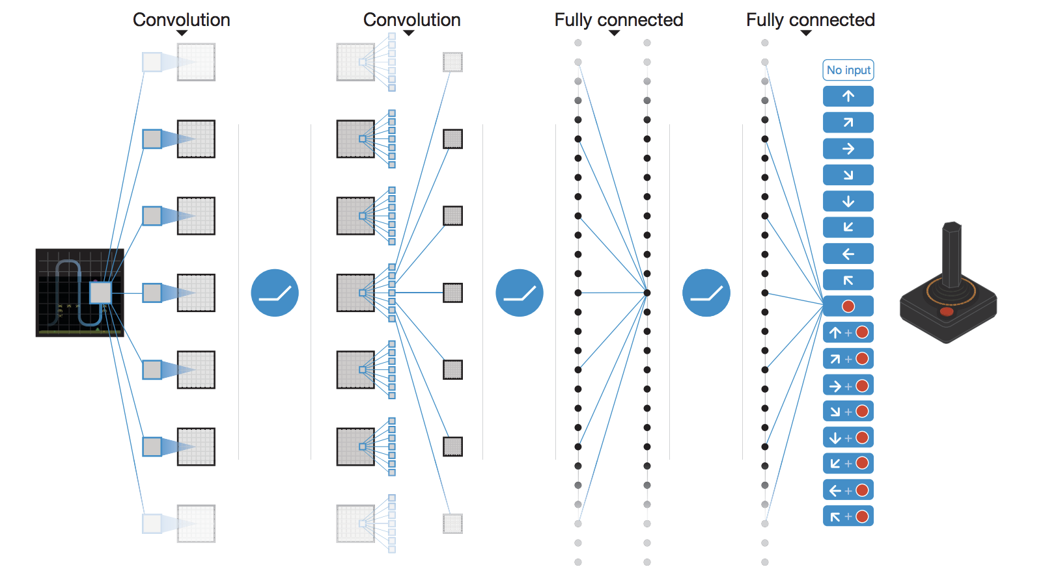
“Deep” networks can have many layers
(there are lots of technical details… more to it than just “add more layers”)

Slide 36
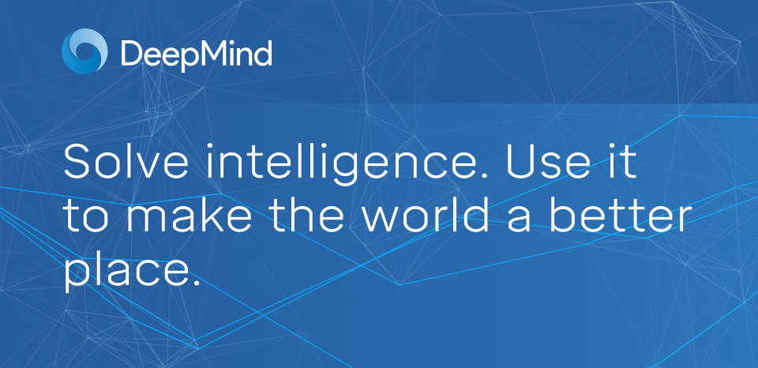
Google DeepMind

Slide 37
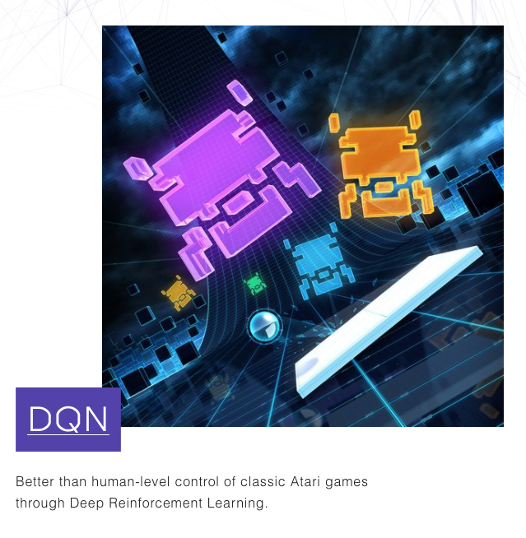
Human level reinforcement learning?

Slide 38
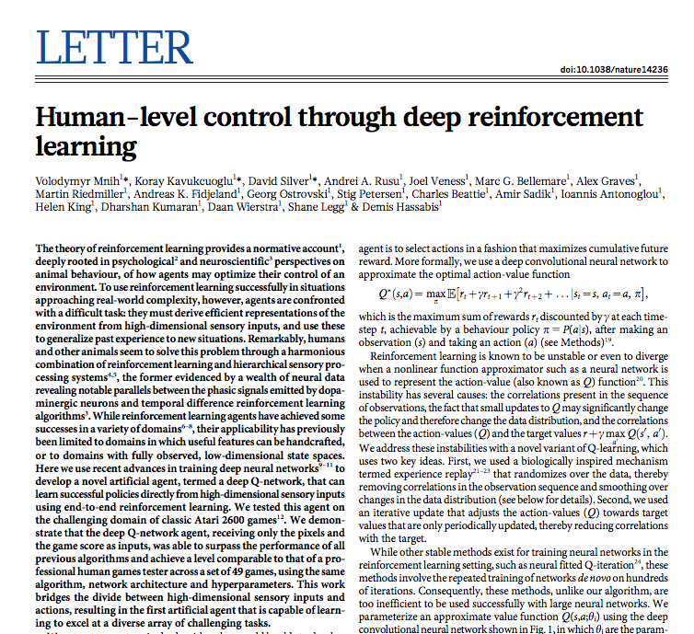
Human level reinforcement learning?
Mnih et al (2015)
https://storage.googleapis.com/deepmind-media/dqn/DQNNaturePaper.pdf

Slide 39
Human level reinforcement learning?
Mnih et al (2015)
The theory of reinforcement learning provides a normative account, deeply rooted in psychological and neuroscientific perspectives on animal behaviour, of how agents may optimize their control of an environment. To use reinforcement learning successfully in situations approaching real-world complexity, however, agents are confronted with a difficult task: they must derive efficient representations of the environment from high-dimensional sensory inputs, and use these to generalize past experience to new situations

Slide 40
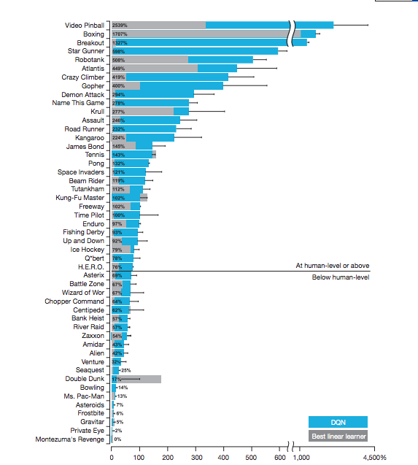
Don’t try to defeat an AI at breakout
Don’t try to defeat an AI at space invaders
Do challenge an AI to play Frostbite!

Slide 41
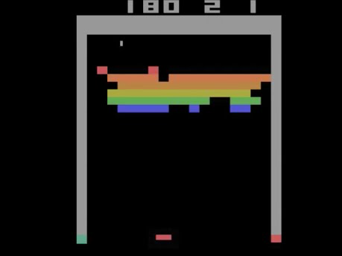
DQN plays Breakout
https://youtu.be/TmPfTpjtdgg

Slide 42
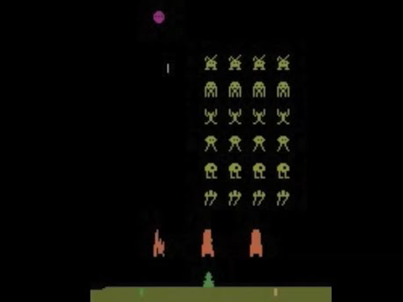
DQN plays Space Invaders
https://youtu.be/W2CAghUiofY

Slide 43
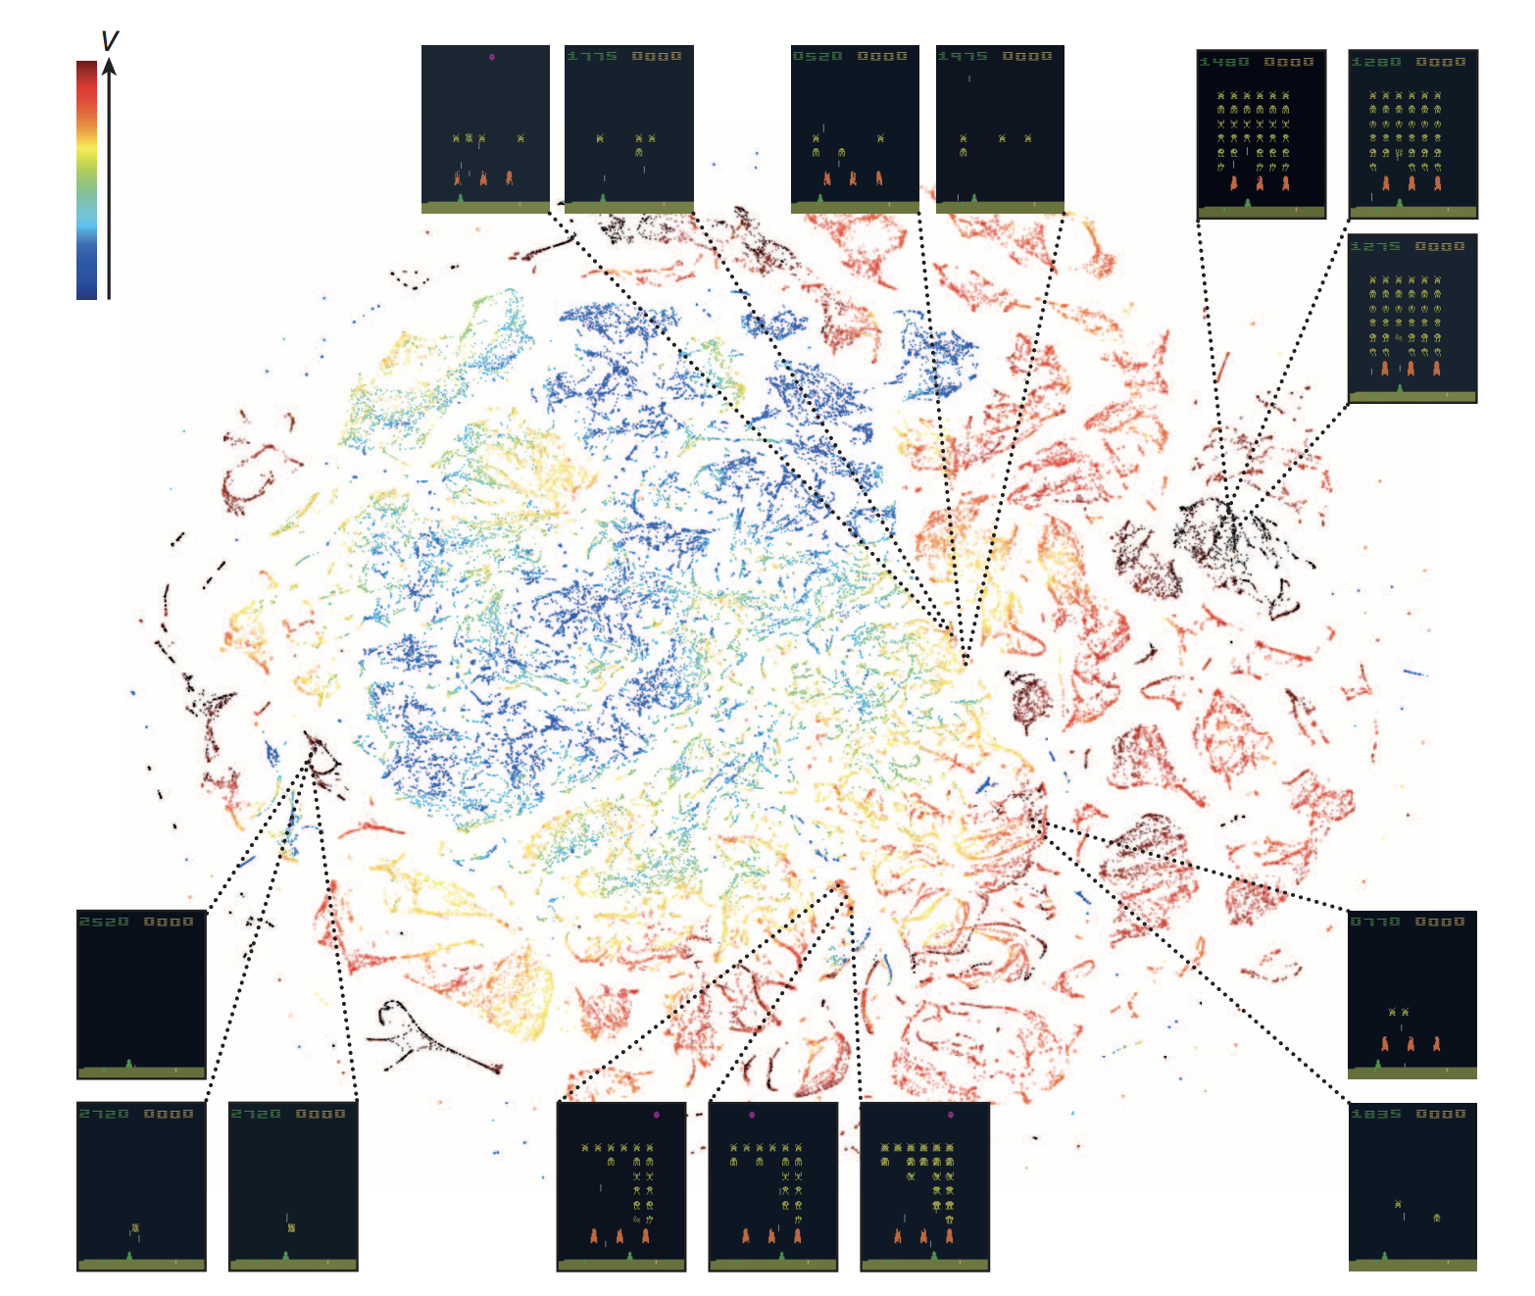
What does it learn?

Slide 44
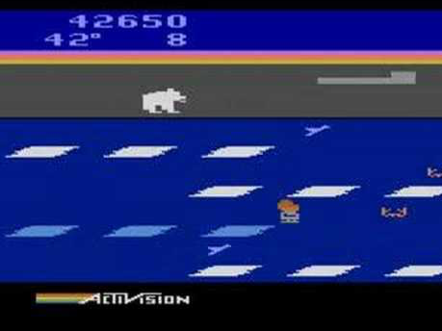
What doesn’t it learn?
(this is a human playing Frostbite)
https://youtu.be/1d4D5KhpKa8

Slide 45
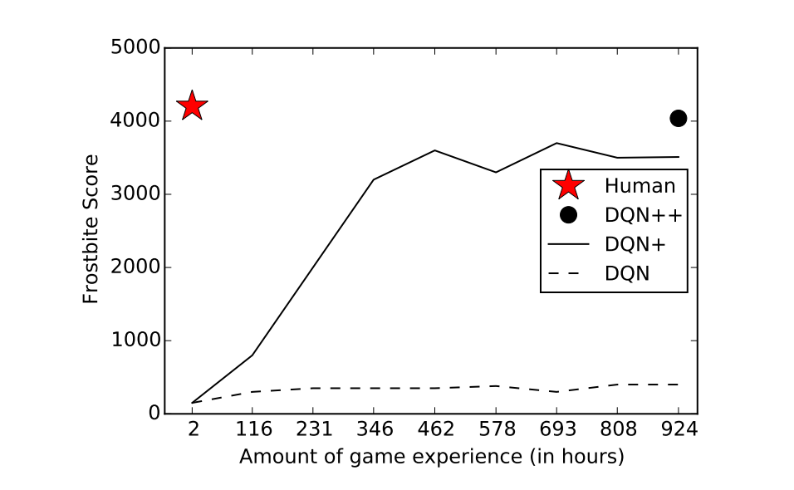
Why is Frostbite hard?
It’s a structured game with sparse rewards
Needs “forward planning” to play well
Not really a “pattern recognition” problem
http://web.stanford.edu/class/psych209/Readings/LakeEtAlBBS.pdf

Slide 46
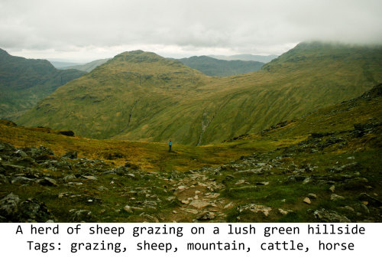
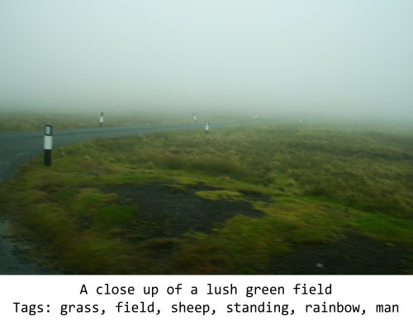
When pattern recognition goes awry
Very cool blog post by Janelle Shane
http://aiweirdness.com/post/171451900302/do-neural-nets-dream-of-electric-sheep
These are scenes that “usually” have sheep so the network (this one is Microsoft, not Google) tags it with sheep

Slide 47
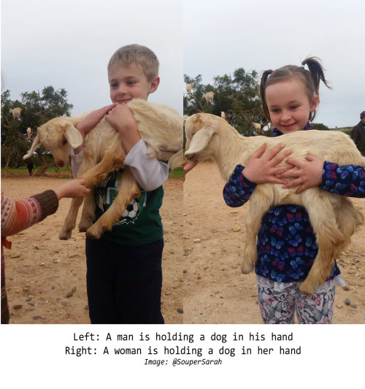
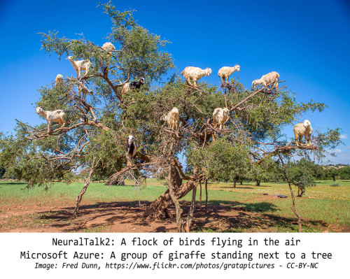
When pattern recognition goes awry
A goat being held by a child is labelled a “dog”
Goats in trees become birds or giraffes

Slide 48
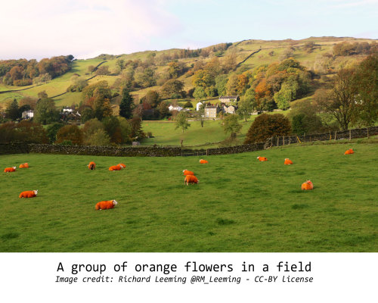
When pattern recognition goes awry
Paint a sheep orange and it becomes a flower

Slide 49
Thanks!

